Slide 1
Current version of the US Congress data

Slide 2
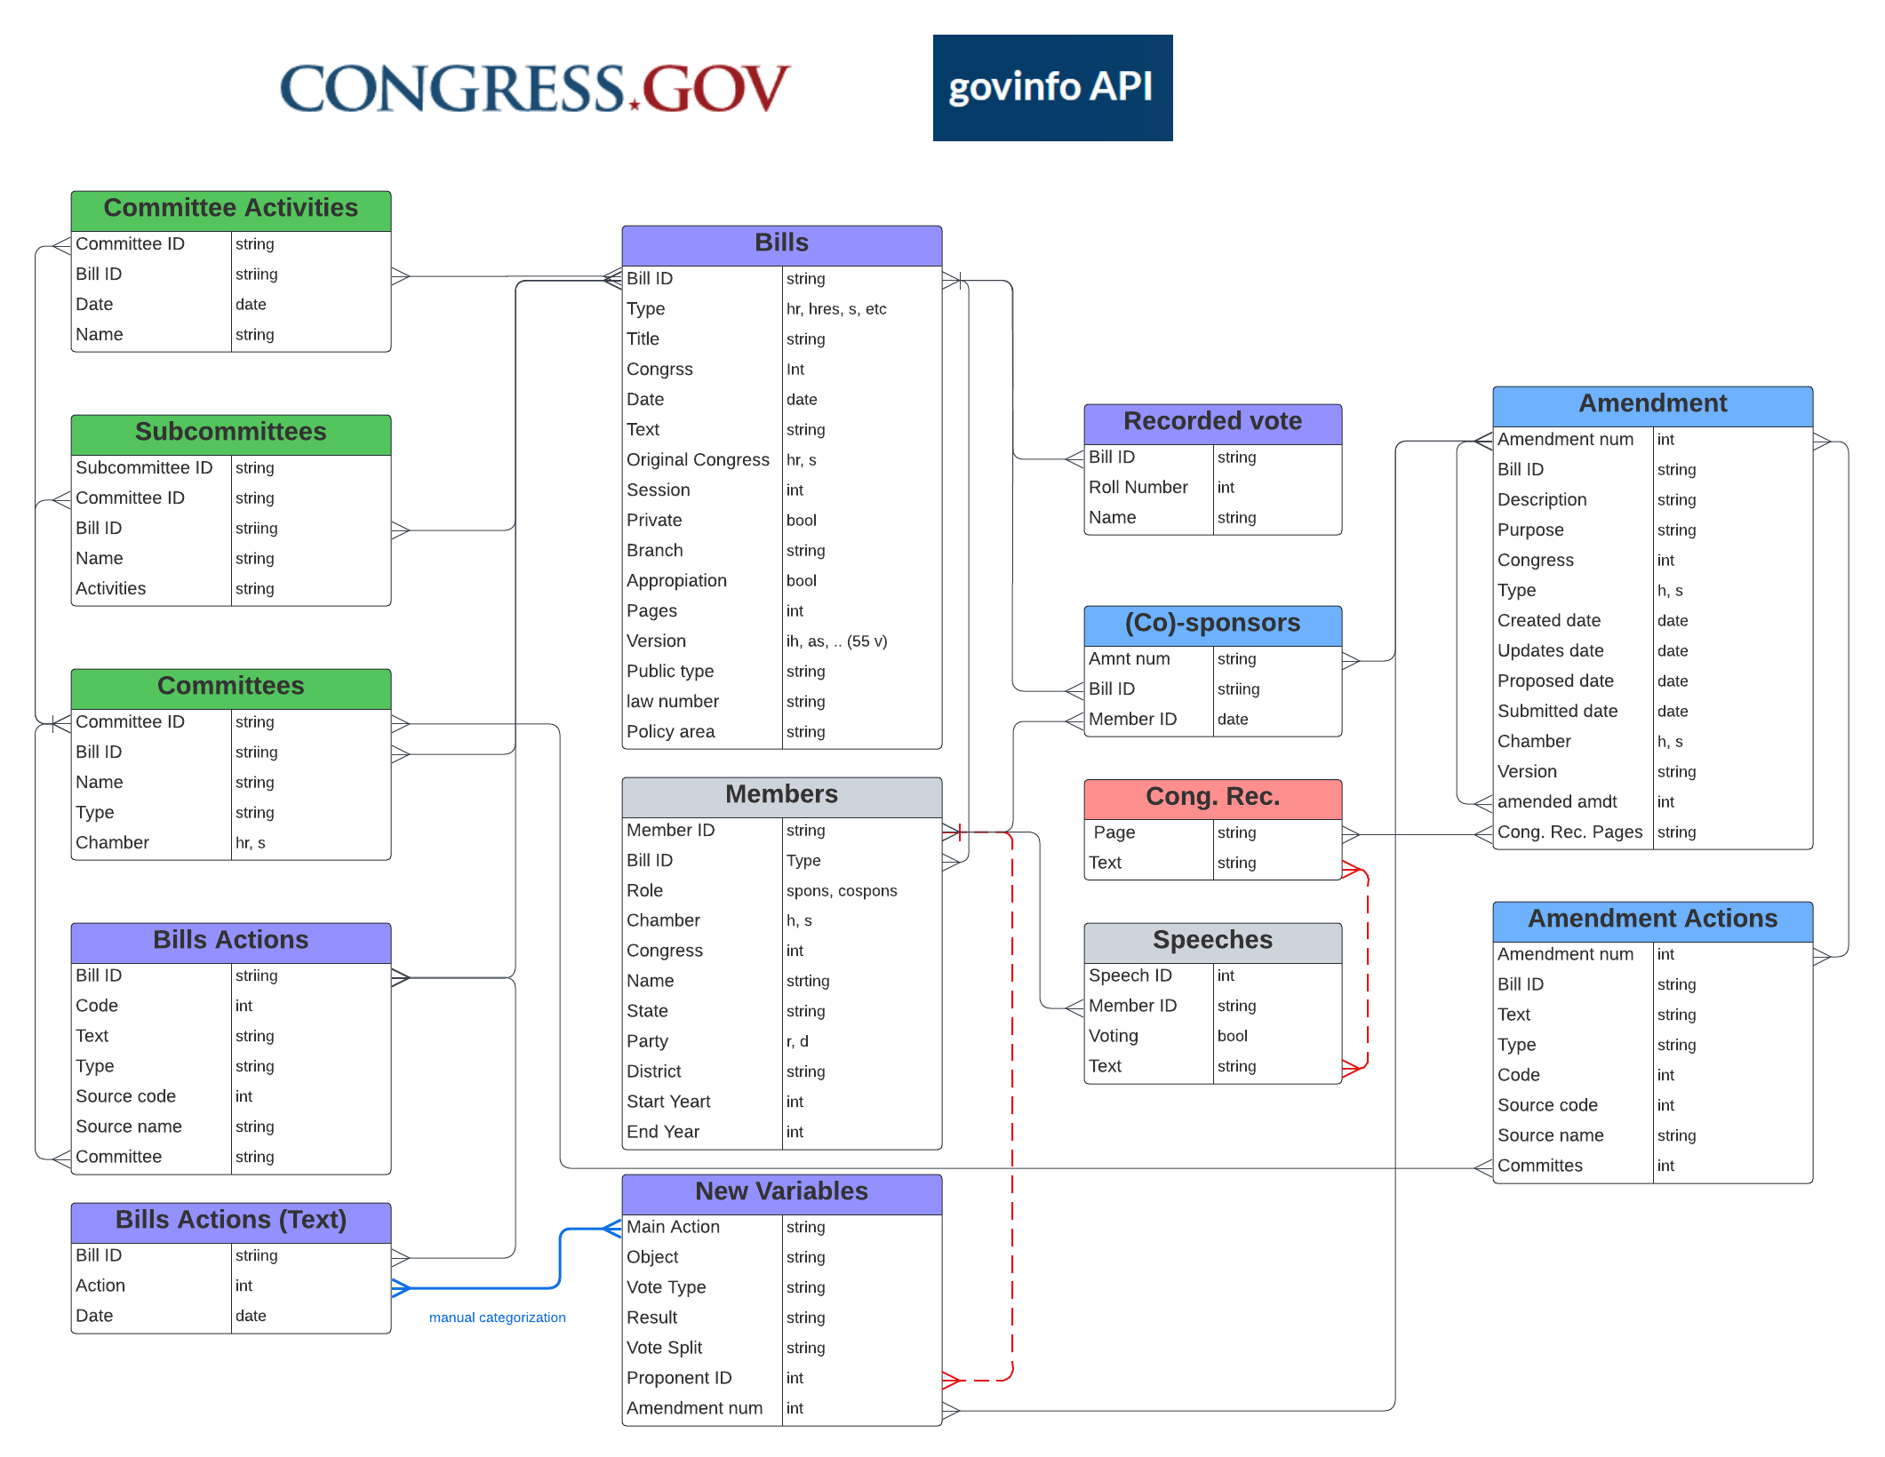
Relational Data Structure

Slide 3

Main Actions Types
Total of 227 main action types
71 categories + codes
7 categories
Official Categorization
Official Aggregate Categories
Introduction and Referral
Committee Consideration
Floor Consideration
Resolving Differences
To President
Veto Consideration
Became Law

